Slide 1
Group 10
Sprint 1

Slide 2
Progress
Roles and Task allocation
Planning and Scheduling
Requirements Analysis
UML Design
Database connectivity
Set up login permissions
Completed login design
Laid out initial code

Slide 3
Roles and task Allocation
(Insert task delivery form)

Slide 4
Planning and Scheduling
(Insert an up to date gant chart)

Slide 5
Requirements analysis
(Insert breakdown of requirements here)

Slide 6
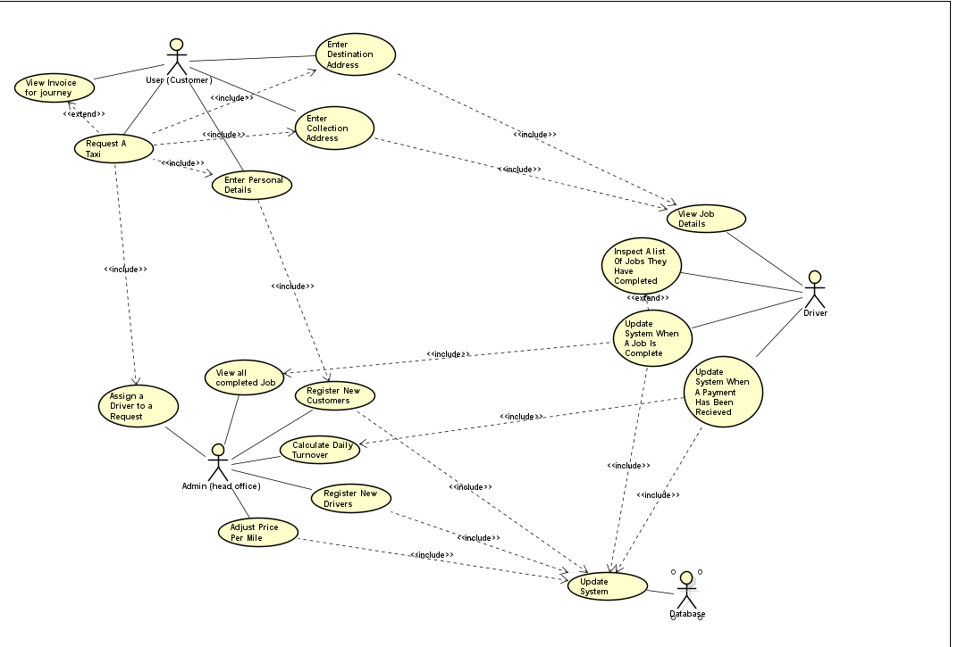
Use Case Diagram

Slide 7
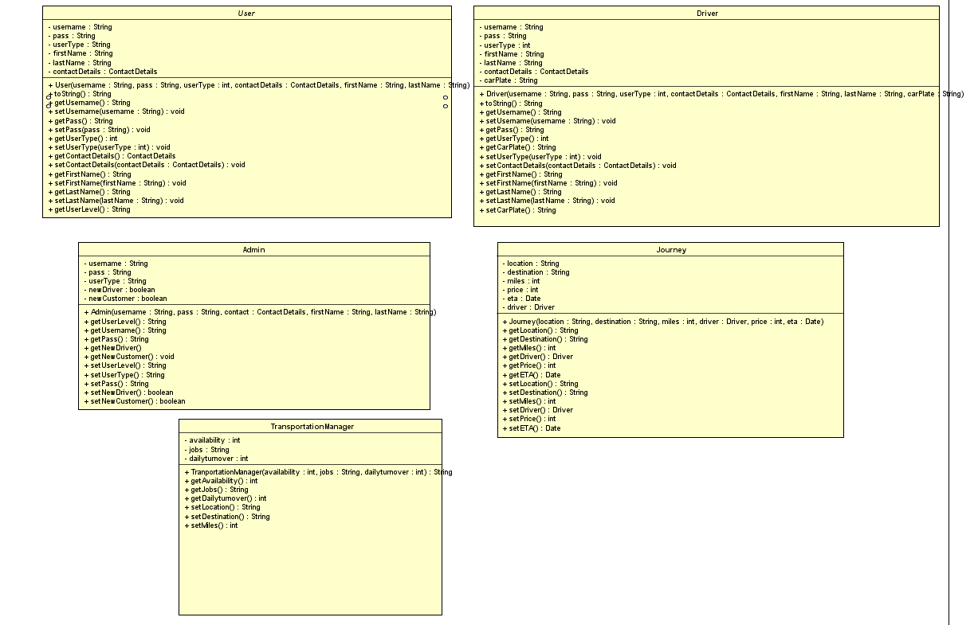
Class Diagram

Slide 8
Database Connectivity
(Insert a copy image of the database connectivity here)

Slide 9
Login Design and Permission
(Explain what we’ve done and how)?

Slide 10
Initial code
(Show initial code here)

